Slide 1


OPER 679 Lesson 16
Dr. Nathan Gaw
Assistant Professor
Department of Operational Sciences
Air Force Institute of Technology
The views expressed in this presentation are those of the author(s) and do not reflect the official policy or position of the United States Air Force, the Department of Defense, or the United States Government.

Slide 2
Previously
We learned how to…
Perform model validation through analysis of model coefficients and predicted values
Perform model validation through analysis of model performance on new data
Perform data splitting using a variety of approaches and explain the advantages and disadvantages of each
Text Covered: Ch. 11.1-11.3

Slide 3
Lesson Objectives
At the end of the session, students will be able to…
Explain the theoretical basis for logistic regression
Perform logistic regression and interpret software output
Perform and interpret statistical inference on a logistic regression model using likelihood ratio test(s)
Calculate deviance residuals and use to check model adequacy
Text Covered: Ch. 13.1-13.2

Slide 4
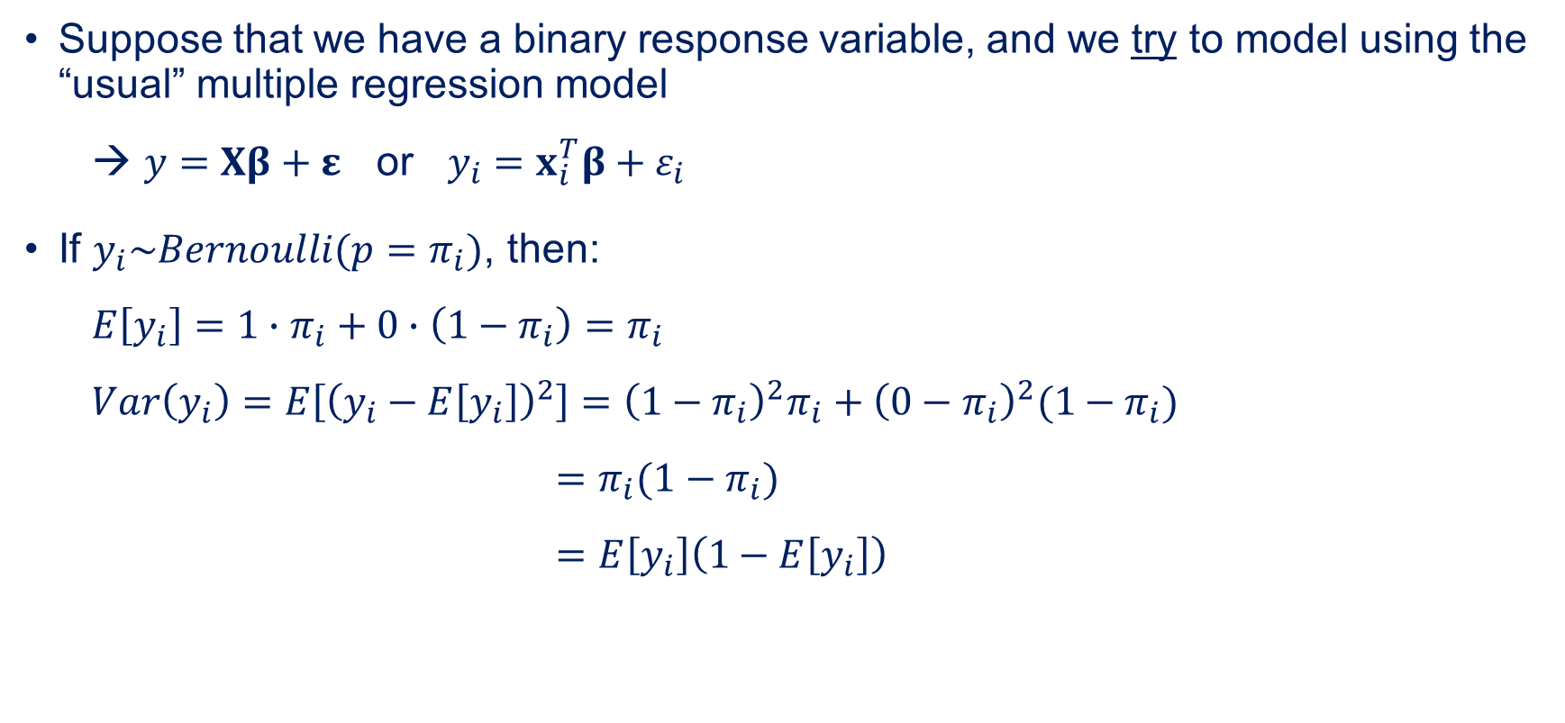
Logistic Regression
Suppose that we have a binary response variable, and we try to model using the “usual” multiple regression model
$y=Xβ+ε$ or $y_{i}=x_{i}^{T}β+ε_{i}$
If $y_{i}\sim Bernoulli(p=π_{i})$, then:
$E\left[y_{i}\right]=1∙π_{i}+0∙\left(1−π_{i}\right)=π_{i}$
$Var\left(y_{i}\right)=E\left[{\left(y_{i}−E\left[y_{i}\right]\right)}^{2}\right]={\left(1−π_{i}\right)}^{2}π_{i}+{\left(0−π_{i}\right)}^{2}(1−π_{i})$
$=π_{i}(1−π_{i})$
$=E\left[y_{i}\right]\left(1−E\left[y_{i}\right]\right)$

Slide 5
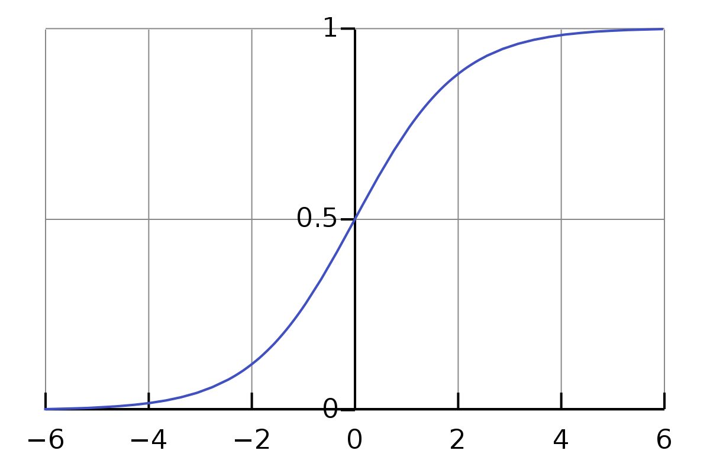



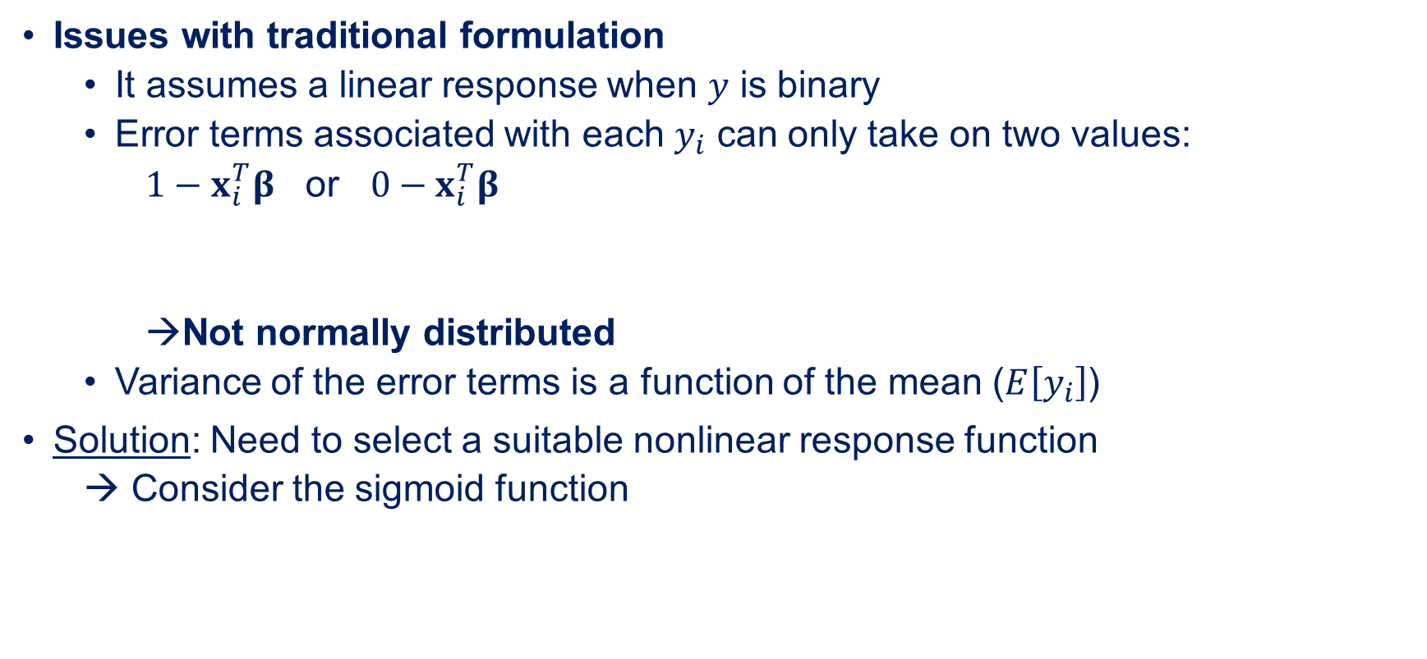
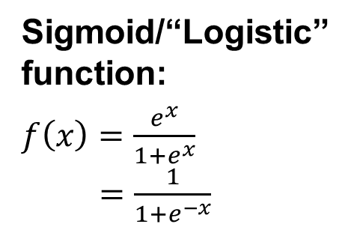

Logistic Regression
Issues with traditional formulation
It assumes a linear response when $y$ is binary
Error terms associated with each $y_{i}$ can only take on two values:
$1−x_{i}^{T}β$ or $0−x_{i}^{T}β$
Not normally distributed
Variance of the error terms is a function of the mean ($E\left[y_{i}\right]$)
Solution: Need to select a suitable nonlinear response function
→ Consider the sigmoid function
Sigmoid/“Logistic” function:
$f\left(x\right)=\frac{e^{x}}{1+e^{x}}$
$=\frac{1}{1+e^{−x}}$
$$y_{i}$$
$$y_{i}$$
$$f(x)$$
S-shaped
(several types)
$$x$$

Slide 6

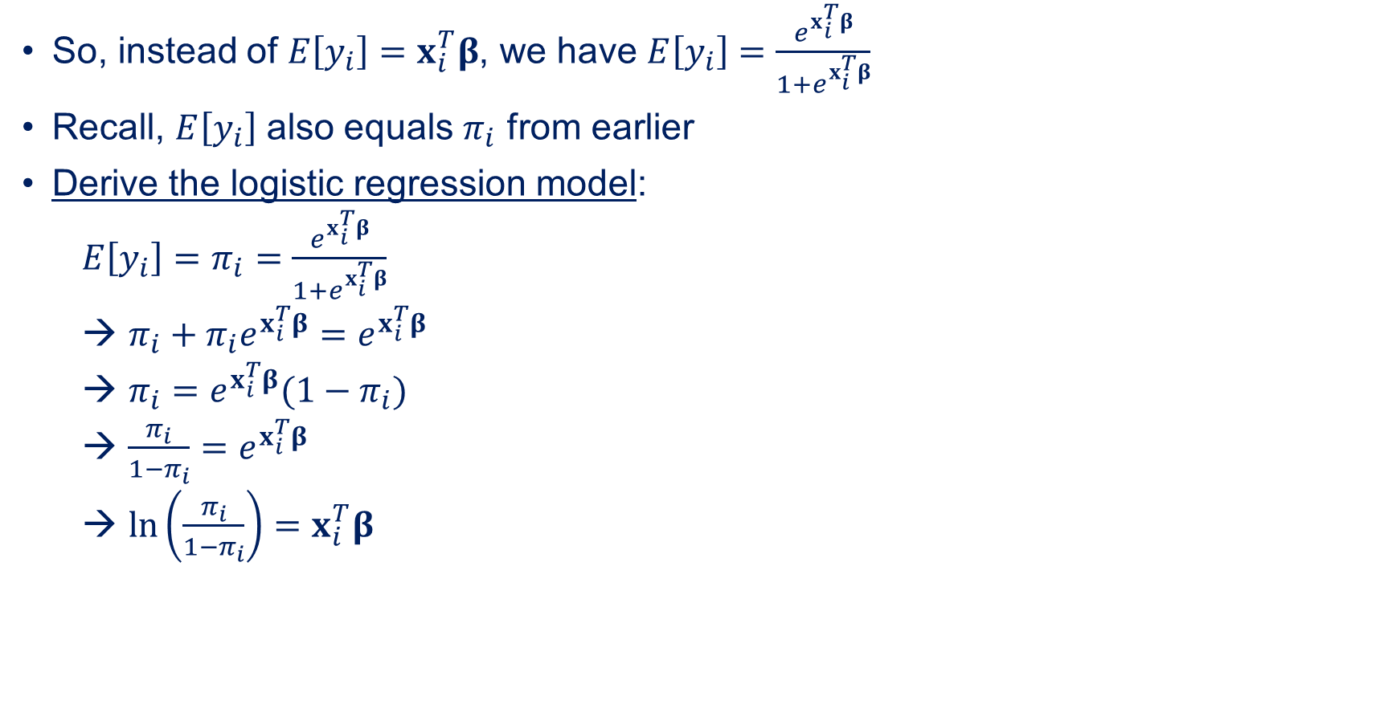
Logistic Regression
So, instead of $E\left[y_{i}\right]=x_{i}^{T}β$, we have $E\left[y_{i}\right]=\frac{e^{x_{i}^{T}β}}{1+e^{x_{i}^{T}β}}$
Recall, $E\left[y_{i}\right]$ also equals $π_{i}$ from earlier
Derive the logistic regression model:
$E\left[y_{i}\right]=π_{i}=\frac{e^{x_{i}^{T}β}}{1+e^{x_{i}^{T}β}}$
$π_{i}+π_{i}e^{x_{i}^{T}β}=e^{x_{i}^{T}β}$
$π_{i}=e^{x_{i}^{T}β}(1−π_{i})$
$\frac{π_{i}}{1−π_{i}}=e^{x_{i}^{T}β}$
$\ln\left(\frac{π_{i}}{1−π_{i}}\right)=x_{i}^{T}β$
→ This is a linear function of the regressors!
We obtain our ${\hat{β}}_{j}$ estimates by regressing $\ln\left(\frac{π_{i}}{1−π_{i}}\right)$ against $x_{i}^{T}β$

Slide 7
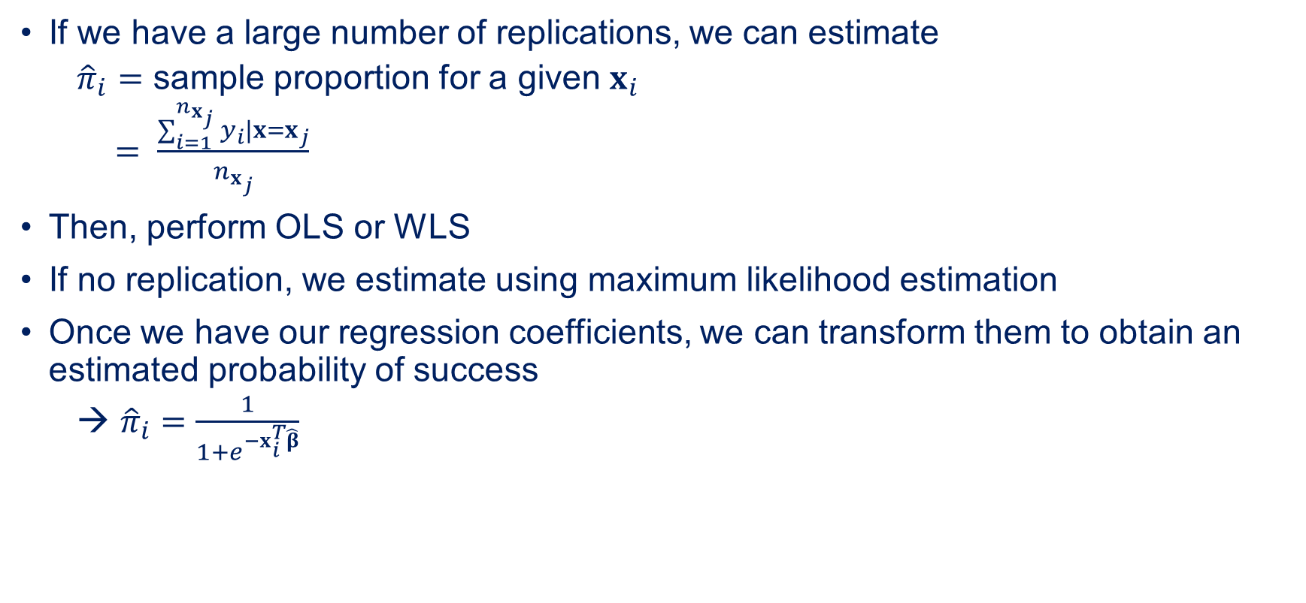
Logistic Regression
If we have a large number of replications, we can estimate
${\hat{π}}_{i}=$ sample proportion for a given $x_{i}$
$= \frac{\sum_{i=1}^{n_{x_{j}}}{y_{i}|x=x_{j}}}{n_{x_{j}}}$
Then, perform OLS or WLS
If no replication, we estimate using maximum likelihood estimation
Once we have our regression coefficients, we can transform them to obtain an estimated probability of success
${\hat{π}}_{i}=\frac{1}{1+e^{−x_{i}^{T}\hat{β}}}$

Slide 8


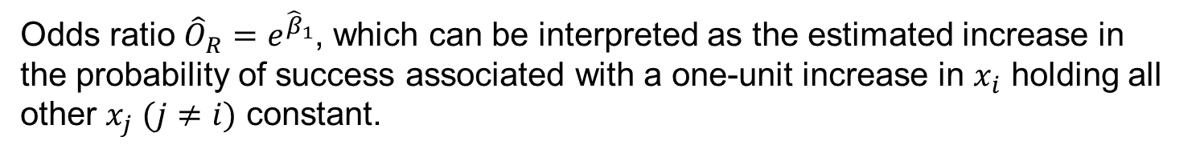
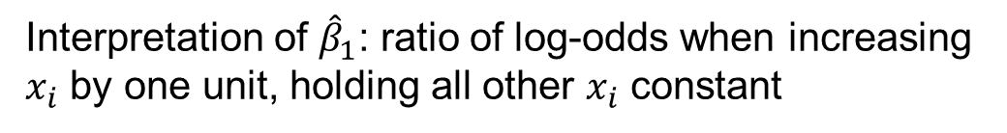

Interpretation of Logistic Regression Parameters
Let $\hat{y}{\left.​\right|}_{x=x_{i}}=\ln\left(\frac{{\hat{π}}_{i}}{1−{\hat{π}}_{i}}\right)=x_{i}^{T}\hat{β}={\hat{β}}_{0}+{\hat{β}}_{1}x_{i}$
Also let $\hat{y}{\left.​\right|}_{x=x_{i}+1}={\hat{β}}_{0}+{\hat{β}}_{1}(x_{i}+1)$ → also in the simple case
$\hat{y}{\left.​\right|}_{x=x_{i}+1}−\hat{y}{\left.​\right|}_{x=x_{i}}={\hat{β}}_{1}$
$\ln\left(\frac{\hat{π}{\left.​\right|}_{x=x_{i}+1}}{1−\hat{π}{\left.​\right|}_{x=x_{i}+1}}\right)−\ln\left(\frac{\hat{π}{\left.​\right|}_{x=x_{i}}}{1−\hat{π}{\left.​\right|}_{x=x_{i}}}\right)={\hat{β}}_{1}$
$\ln\left(\frac{Odds_{x_{i}+1}}{Odds_{x_{i}}}\right)={\hat{β}}_{1}$
In the simple case
$$Odds_{x_{i}+1}$$
$$Odds_{x_{i}}$$
Interpretation of ${\hat{β}}_{1}$: ratio of log-odds when increasing $x_{i}$ by one unit, holding all other $x_{i}$ constant
Odds ratio ${\hat{O}}_{R}=e^{{\hat{β}}_{1}}$, which can be interpreted as the estimated increase in the probability of success associated with a one-unit increase in $x_{i}$ holding all other $x_{j} (j≠i)$ constant.

Slide 9
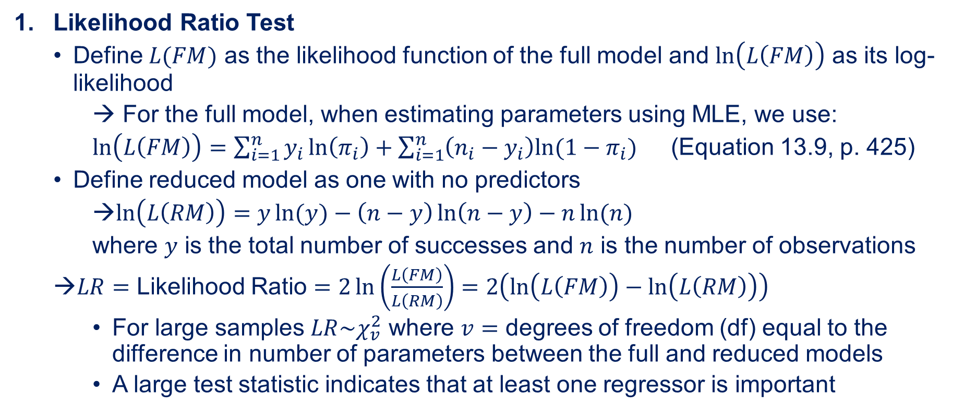
Statistical Inference on Model Parameters
Likelihood Ratio Test
Define $L(FM)$ as the likelihood function of the full model and $\ln\left(L\left(FM\right)\right)$ as its log-likelihood
→ For the full model, when estimating parameters using MLE, we use:
$\ln\left(L\left(FM\right)\right)=\sum_{i=1}^{n}{y_{i}\ln\left(π_{i}\right)+\sum_{i=1}^{n}{\left(n_{i}−y_{i}\right)ln⁡(1−π_{i})}}$ (Equation 13.9, p. 425)
Define reduced model as one with no predictors
$\ln\left(L\left(RM\right)\right)=y\ln{(y)}−\left(n−y\right)\ln\left(n−y\right)−n\ln{(n)}$
where $y$ is the total number of successes and $n$ is the number of observations
$LR=$ Likelihood Ratio $=2\ln\left(\frac{L\left(FM\right)}{L\left(RM\right)}\right)=2\left(\ln\left(L\left(FM\right)\right)−\ln\left(L\left(RM\right)\right)\right)$
For large samples $LR\sim χ_{v}^{2}$ where $v=$ degrees of freedom (df) equal to the difference in number of parameters between the full and reduced models
A large test statistic indicates that at least one regressor is important

Slide 10
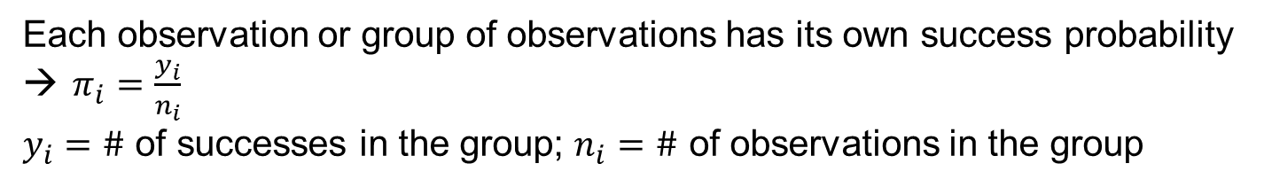
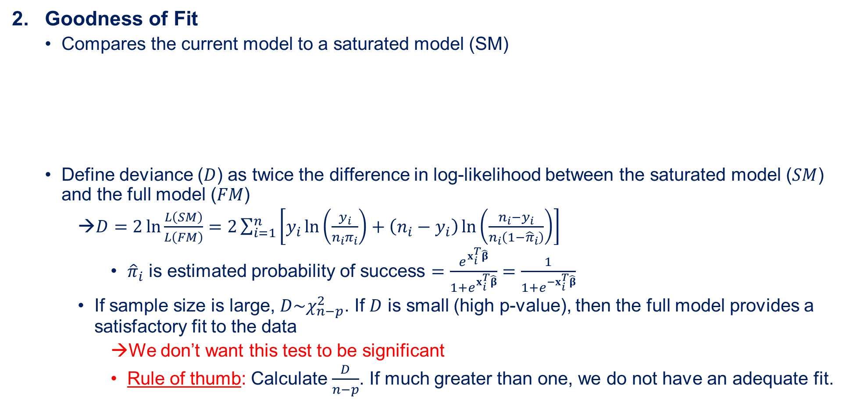
Statistical Inference on Model Parameters
Goodness of Fit
Compares the current model to a saturated model (SM)
Define deviance ($D$) as twice the difference in log-likelihood between the saturated model ($SM$) and the full model ($FM$)
$D=2\ln{\frac{L\left(SM\right)}{L\left(FM\right)}}=2\sum_{i=1}^{n}{\left[y_{i}\ln\left(\frac{y_{i}}{n_{i}π_{i}}\right)+\left(n_{i}−y_{i}\right)\ln\left(\frac{n_{i}−y_{i}}{n_{i}\left(1−{\hat{π}}_{i}\right)}\right)\right]}$
${\hat{π}}_{i}$ is estimated probability of success $=\frac{e^{x_{i}^{T}\hat{β}}}{1+e^{x_{i}^{T}\hat{β}}}=\frac{1}{1+e^{−x_{i}^{T}\hat{β}}}$
If sample size is large, $D\sim χ_{n−p}^{2}$. If $D$ is small (high p-value), then the full model provides a satisfactory fit to the data
We don’t want this test to be significant
Rule of thumb: Calculate $\frac{D}{n−p}$. If much greater than one, we do not have an adequate fit.
Each observation or group of observations has its own success probability
$π_{i}=\frac{y_{i}}{n_{i}}$
$y_{i}=\#$ of successes in the group; $n_{i}=\#$ of observations in the group

Slide 11
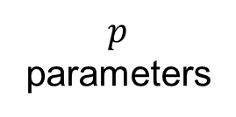
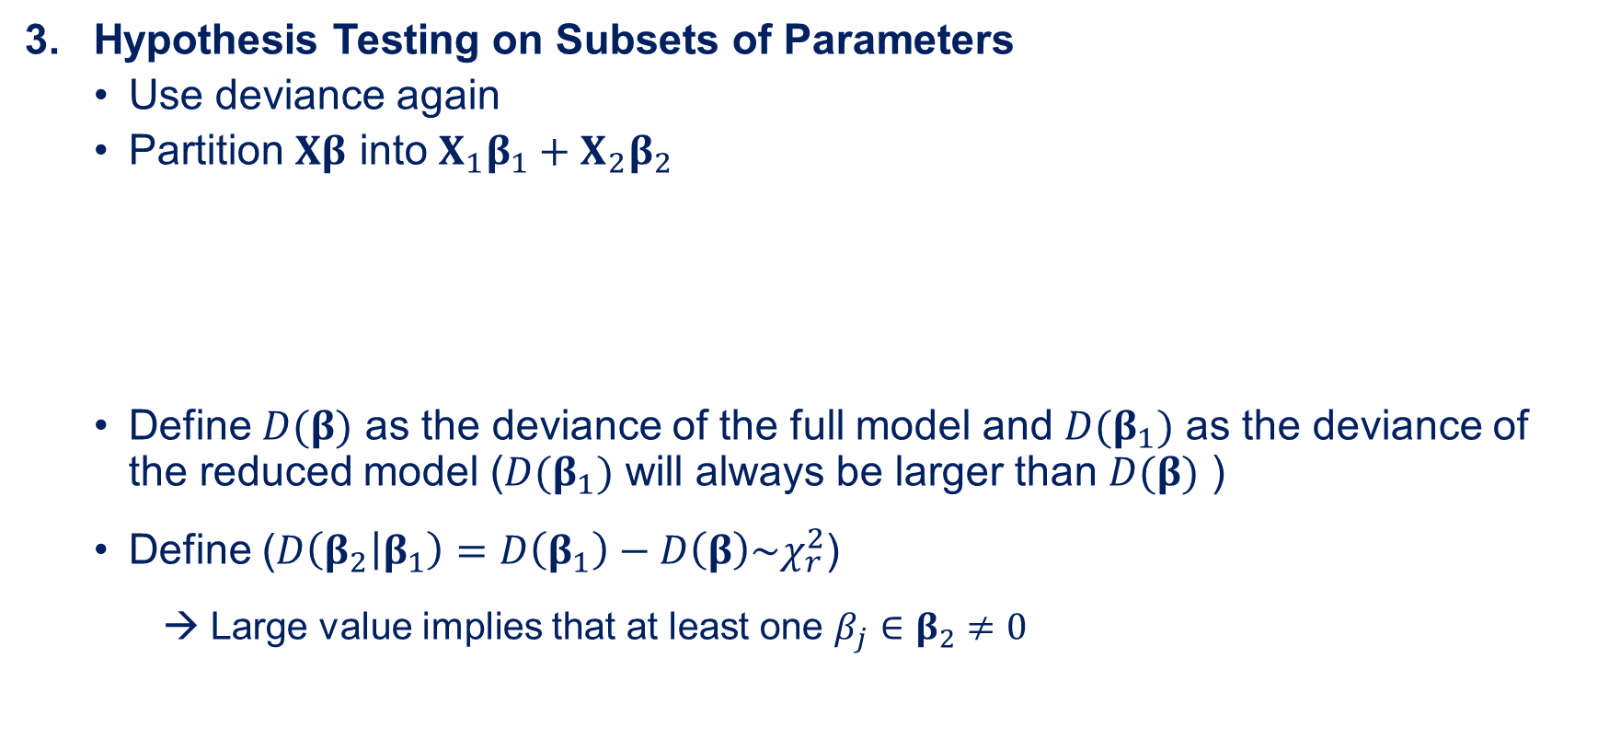
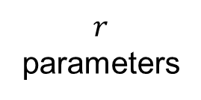
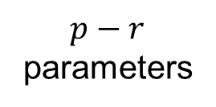
Statistical Inference on Model Parameters
Hypothesis Testing on Subsets of Parameters
Use deviance again
Partition $Xβ$ into $X_{1}β_{1}+X_{2}β_{2}$
Define $D(β)$ as the deviance of the full model and $D(β_{1})$ as the deviance of the reduced model ($D(β_{1})$ will always be larger than $D(β)$ )
Define ($D\left(β_{2} | β_{1}\right)=D\left(β_{1}\right)−D\left(β\right)\sim χ_{r}^{2}$)
→ Large value implies that at least one $β_{j}∈β_{2}≠0$
$p−r$ parameters
$p$ parameters
$r$ parameters

Slide 12

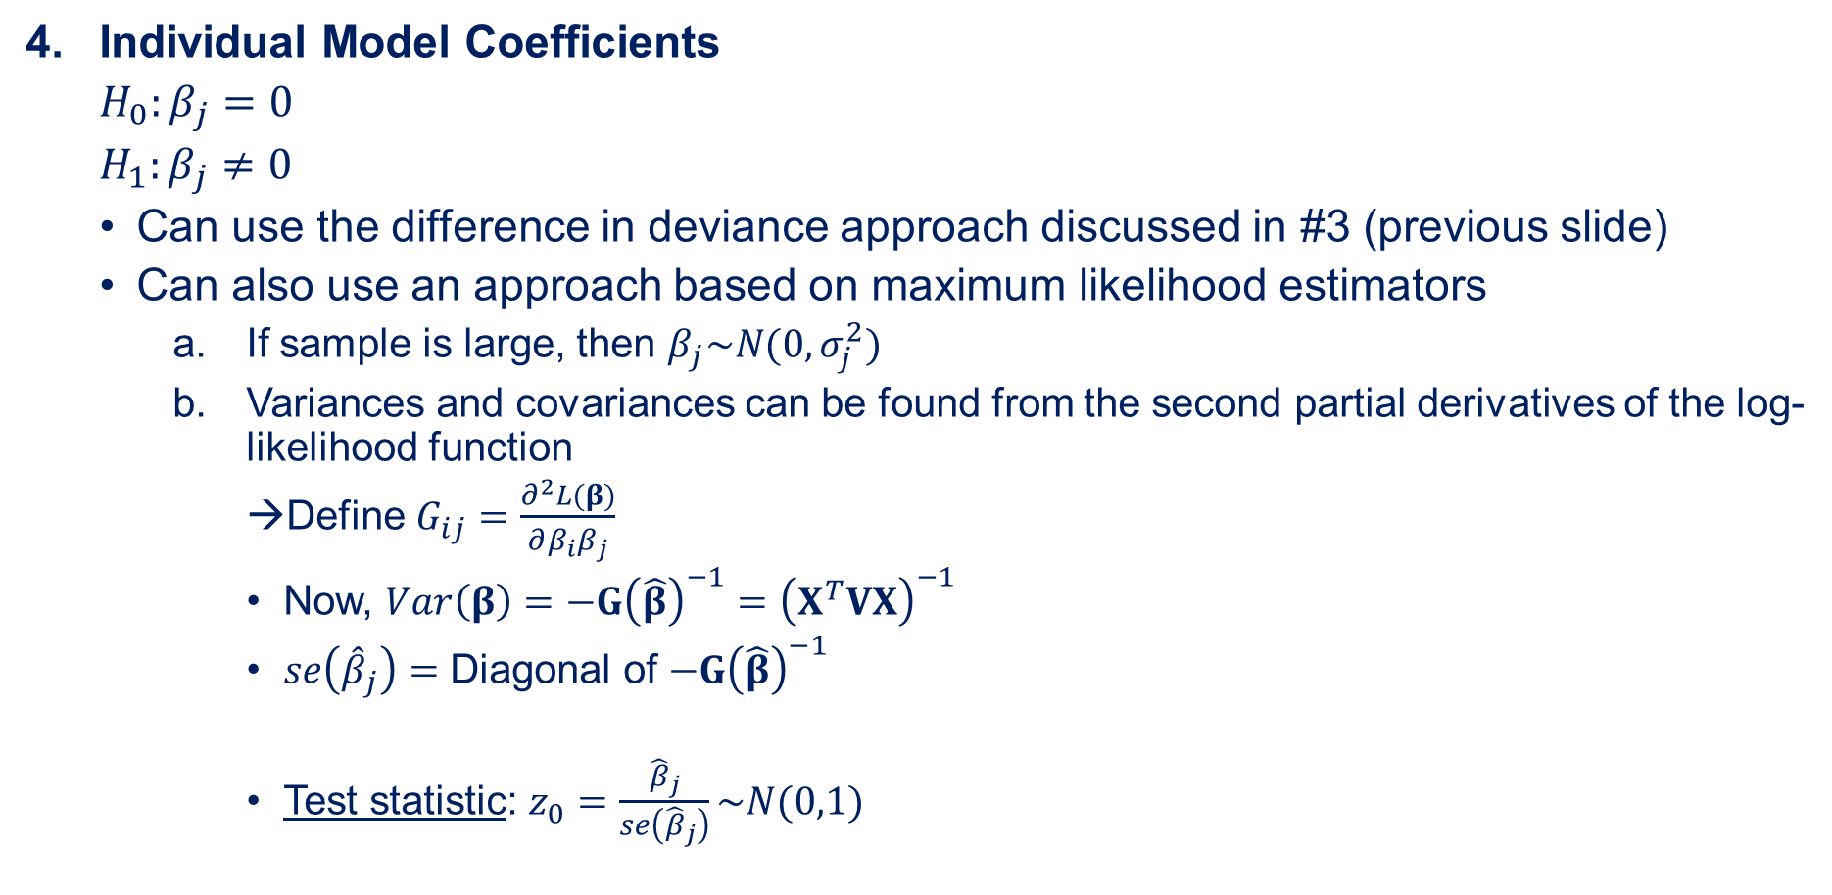

Statistical Inference on Model Parameters
Individual Model Coefficients
$H_{0}:β_{j}=0$
$H_{1}:β_{j}≠0$
Can use the difference in deviance approach discussed in #3 (previous slide)
Can also use an approach based on maximum likelihood estimators
If sample is large, then $β_{j}\sim N(0,σ_{j}^{2})$
Variances and covariances can be found from the second partial derivatives of the log-likelihood function
Define $G_{ij}=\frac{∂^{2}L(β)}{∂β_{i}β_{j}}$
Now, $Var\left(β\right)=−G{\left(\hat{β}\right)}^{−1}={\left(X^{T}VX\right)}^{−1}$
$se\left({\hat{β}}_{j}\right)=$ Diagonal of $−G{\left(\hat{β}\right)}^{−1}$
Test statistic: $z_{0}=\frac{{\hat{β}}_{j}}{se\left({\hat{β}}_{j}\right)}\sim N(0,1)$
$G$ is a $p×p$ matrix of 2nd partial derivatives called a Hessian matrix
$V$ is an $n×n$ diagonal matrix with estimated variance of each observation on the main diagonal.

Slide 13
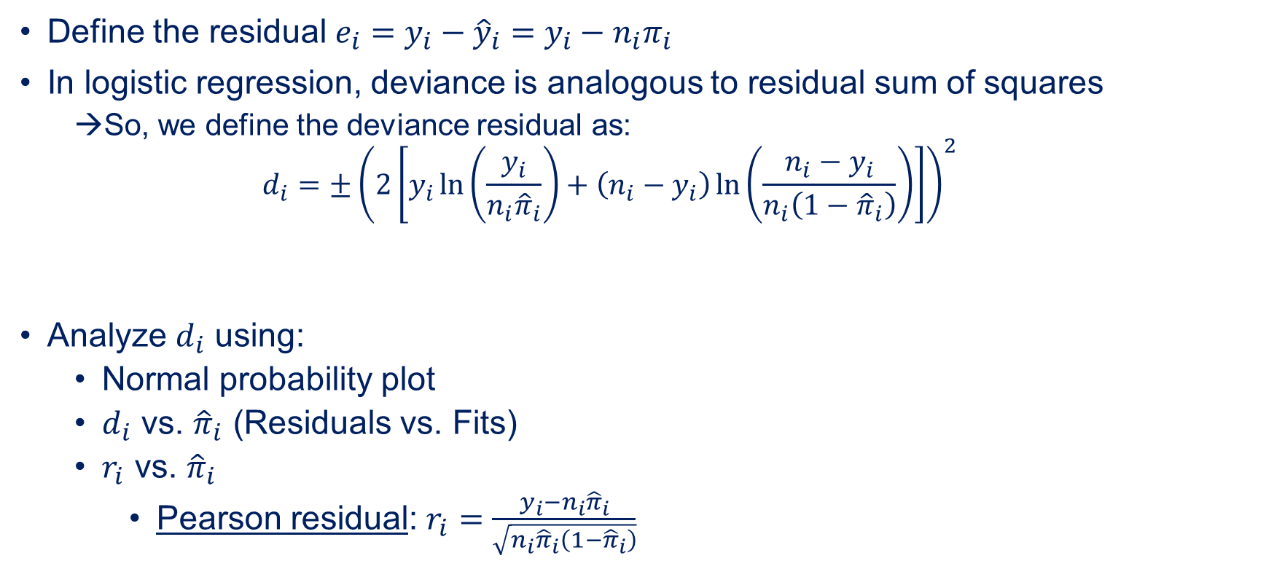
Diagnostic Checking
Define the residual $e_{i}=y_{i}−{\hat{y}}_{i}=y_{i}−n_{i}π_{i}$
In logistic regression, deviance is analogous to residual sum of squares
So, we define the deviance residual as:
$$d_{i}=±{\left(2\left[y_{i}\ln\left(\frac{y_{i}}{n_{i}{\hat{π}}_{i}}\right)+\left(n_{i}−y_{i}\right)\ln\left(\frac{n_{i}−y_{i}}{n_{i}\left(1−{\hat{π}}_{i}\right)}\right)\right]\right)}^{2}$$
Analyze $d_{i}$ using:
Normal probability plot
$d_{i}$ vs. ${\hat{π}}_{i}$ (Residuals vs. Fits)
$r_{i}$ vs. ${\hat{π}}_{i}$
Pearson residual: $r_{i}=\frac{y_{i}−n_{i}{\hat{π}}_{i}}{\sqrt{n_{i}{\hat{π}}_{i}\left(1−{\hat{π}}_{i}\right)}}$
Sign of $d_{i}$ is the same as the sign of the ordinary residual.

Slide 14
Lesson Objectives
At the end of the session, you should now be able to…
Explain the theoretical basis for logistic regression
Perform logistic regression and interpret software output
Perform and interpret statistical inference on a logistic regression model using likelihood ratio test(s)
Calculate deviance residuals and use to check model adequacy
Text Covered: Ch. 13.1-13.2

